Slide 1
MeAsurement of F₂^{n}/F₂^{p}, d/u RAtios and A=3 EMC Effect in Deep Inelastic Electron Scattering Off the Tritium and Helium MirrOr Nuclei
(JLab Conditionally Approved Experiment E12-10-103)
Roy Holt
for Makis Petratos
for the JLab MARATHON Collaboration
HiX October 14, 2010
Jefferson Lab

Slide 2
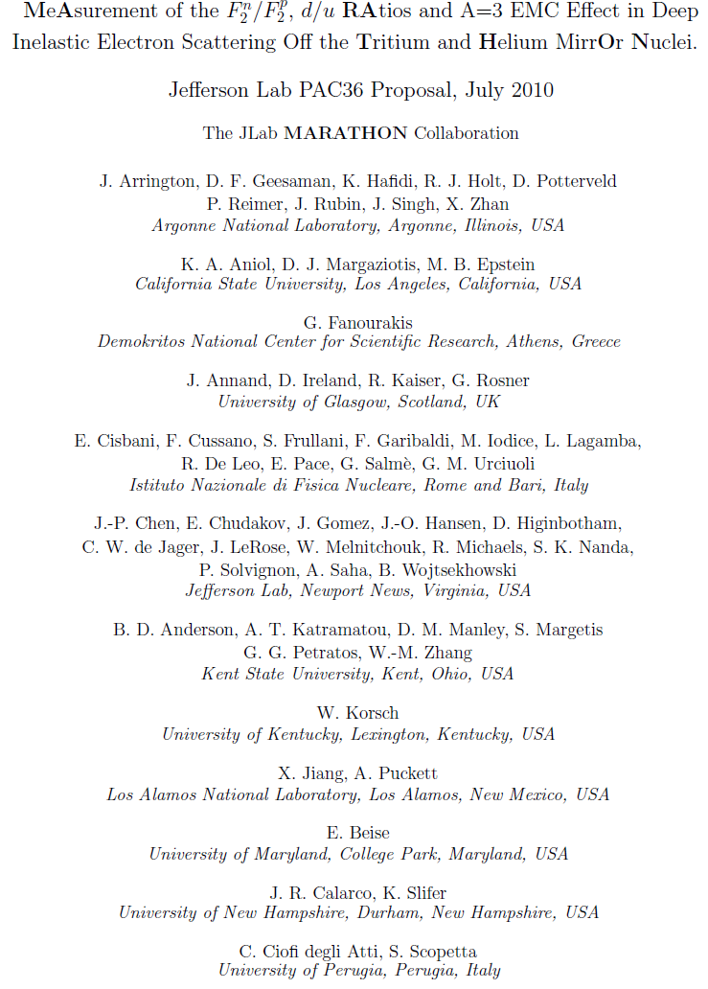
PAC36: Conditional approval based on
detailed detector design
Previous conditional approval by
PAC30 on “review of safety
aspects of ³H target” removed!

Slide 3
Electron-Nucleon Deep Inelastic Scattering (DIS):
Interaction is mediated via exchange of a virtual
photon absorbed by one of the nucleon’s quarks.
Nucleon breaks up into several X hadrons.
X
e’
γ★
Q²
e
N

Slide 4
DIS and Quark Parton Model
Cross Section – Nucleon structure functions F₁ and F₂:
Quark-Parton Model (QPM) interpretation in terms of
quark probability distributions q_{i}(x) (large Q² and ν):
Bjorken x: fraction of nucleon momentum carried by
struck quark:

Slide 5
F₂^{n}/F₂^{p} in Quark Parton Model
Assume isospin symmetry:
Proton and neutron structure functions:
Nachtmann inequality:

Slide 6
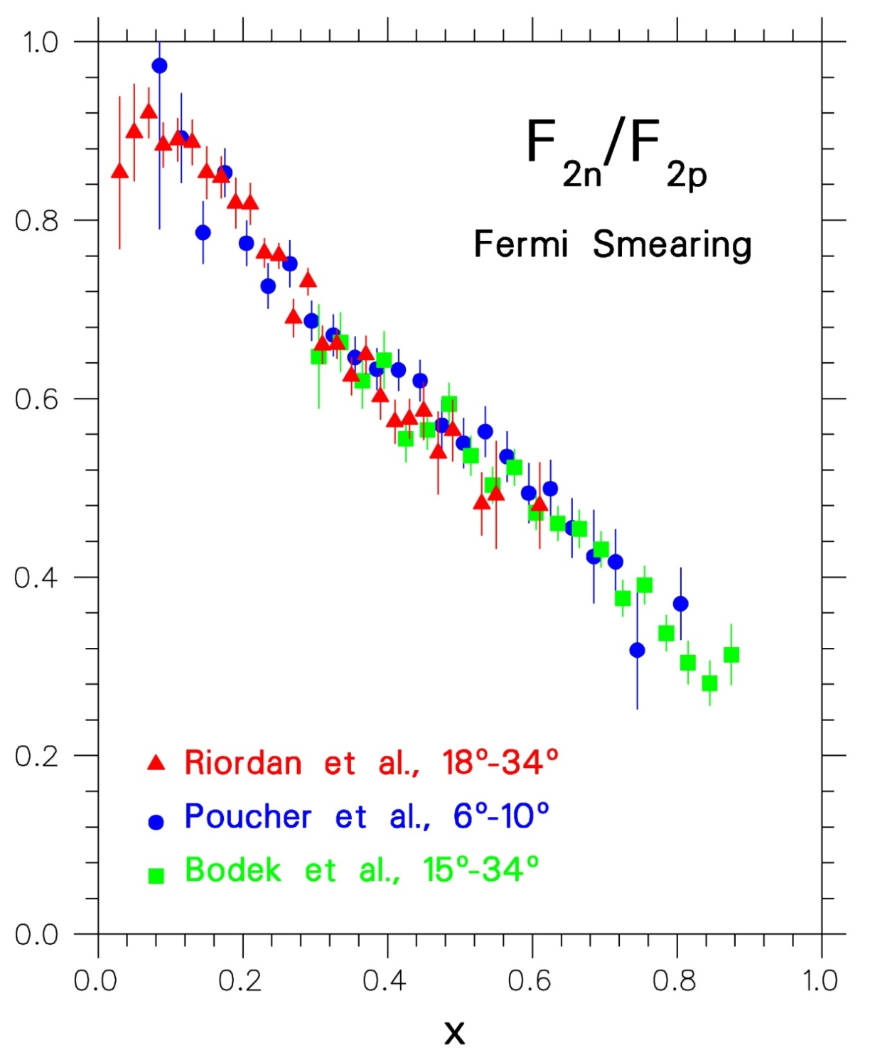
SLAC Measurements
End Station A
1968-1972
Friedman, Kendall, Taylor
Nobel 1991
F₂^{n}/F₂^{p} extracted from proton
and deuterium deep inelastic
data using Hamada-Johnston
potential in a Fermi-smearing
model.
Data in disagreement with
SU(6) prediction: 2/3=0.67!

Slide 7
SLAC/MIT and (later) CERN Data
Nachtmann inequality satisfied:
For x → 0 : F₂^{n}/F₂^{p} → 1: Sea quarks dominate with:
For x → 1 : F₂^{n}/F₂^{p} → 1/4: High momentum partons
in proton (neutron) are up (down) quarks, and:
For medium and high x, safe to assume that (with d
and u denoting now quark plus antiquark distributions):

Slide 8
Neutron Structure Function at high x
I.C. Cloët, C.D. Roberts, et al.
arXiv:0812.0416 [nucl-th]
SU(6) symmetry
Reviews:
S. Brodsky et al.
NP B441 (1995),
W. Melnitchouk and A.Thomas
PL B377 (1996) 11
N. Isgur,
PRD 59 (1999)
R. J. Holt and C. D. Roberts
RMP (2010)
pQCD
DSE: 0⁺ & 1⁺ qq
0⁺ qq only
Craig Roberts, Argonne National Laboratory
8

Slide 9
EMC Effect
Nuclear F₂ structure function per nucleon is different from that of deuterium: large x and A dependence.
Quark distribution functions modified in the nuclear medium.
No universally accepted theory for the effect.
A=3 data will be pivotal for understanding the EMC effect.
Theorists: Ratio of EMC effect for ³H and ³He is the best quantity for quantitative check of the theory, free of most uncertainties.

Slide 10
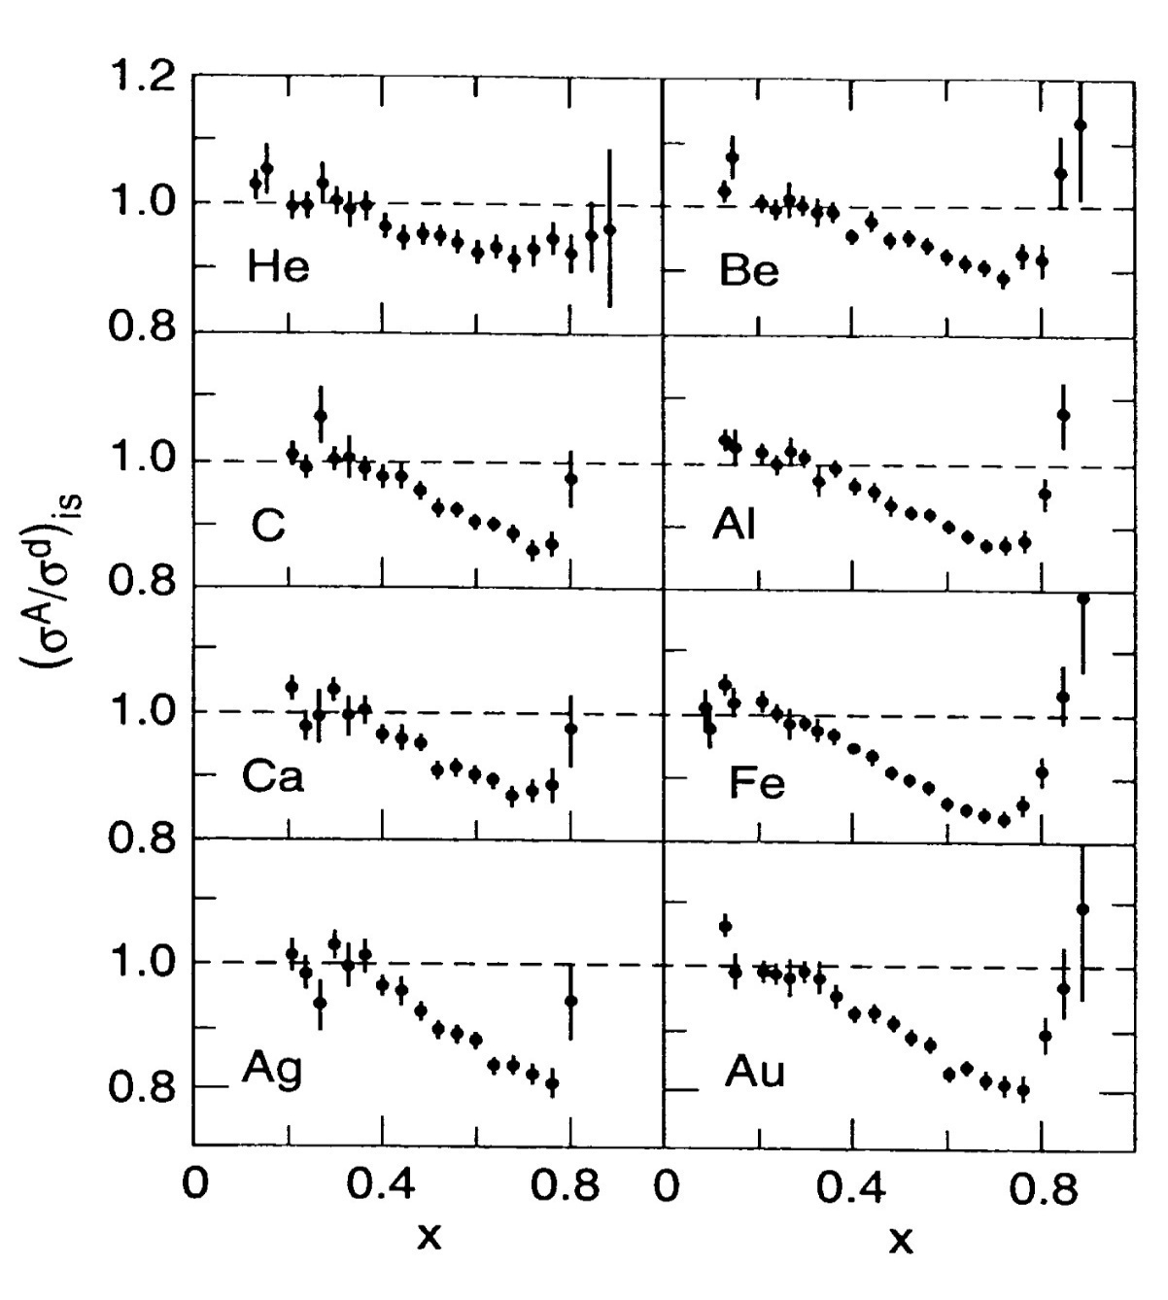
A Dependence
EMC Effect
SLAC E-139, 1984
J. Gomez et al.
Nucleon momentum probability
distributions in nuclei different
from those in deuterium. Effect
increases with mass number A.

Slide 11
Structure Function Ratio Problem
Convolution model
Fermi motion and binding, covariant deuteron wave function, off-shell effects
Melnitchouk and Thomas (1996)
Nuclear density model:
EMC effect for deuteron scales with nuclear density.
Frankfurt and Strikman (1988)
Nuclear density
model
Smearing + binding
Fermi smearing

Slide 12
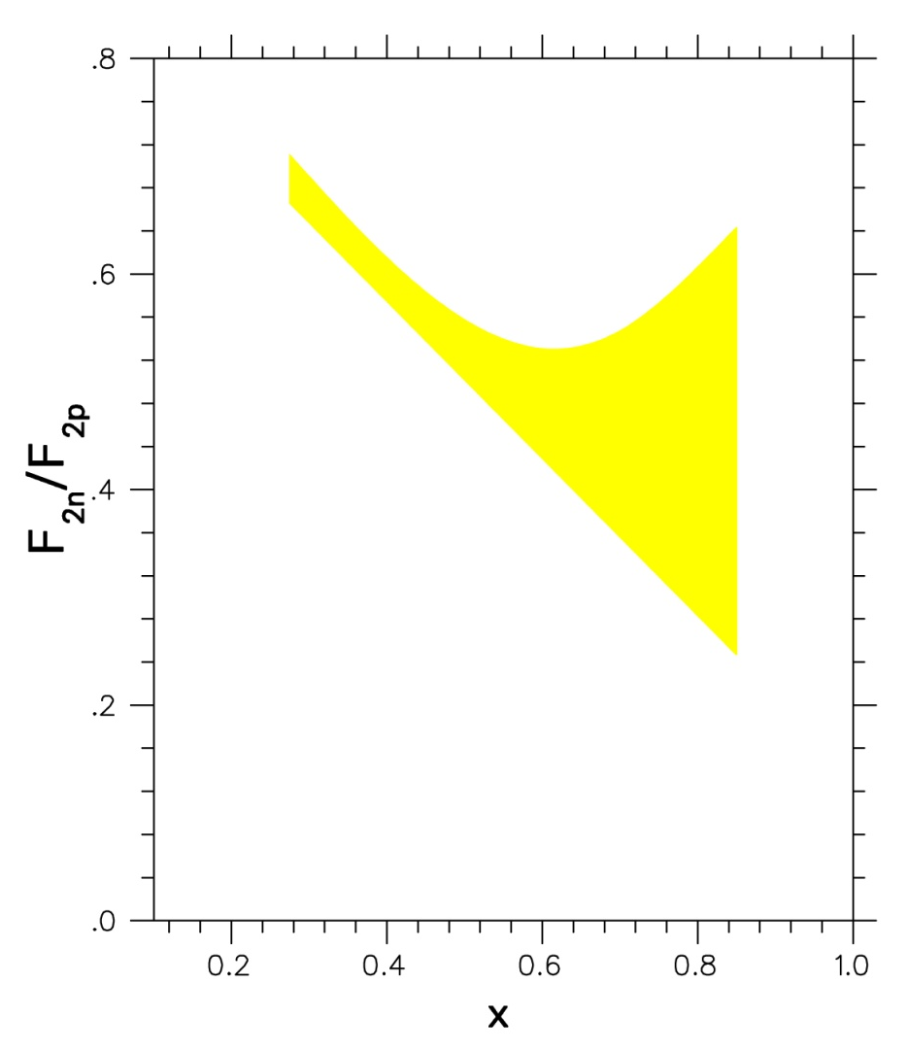
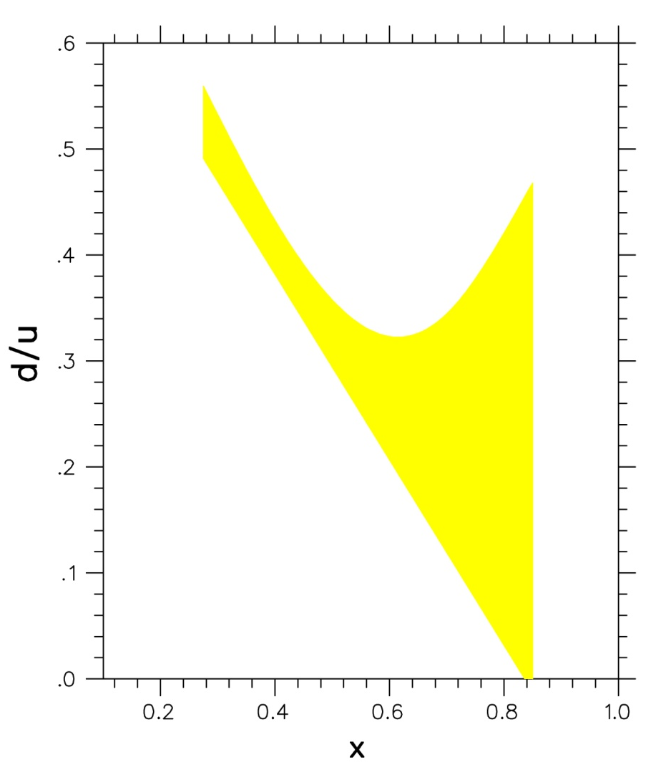
The three analysis methods indicate tremendous uncertainties in high-x behavior of F₂^{n}/F₂^{p} and d/u ratios … d/u essentially unknown at large x!

Slide 13
Nucleon F₂ Ratio Extraction from ³He/³H
Form the “SuperRatio” of EMC ratios for A=3 mirror nuclei:
If R=σ_{L}/ σ_{T} is the same for ³He and ³H, measured DIS cross
section ratio must be equal to the structure function ratio as
calculated from above equations:
Solve for the nucleon F₂ ratio and calculate R* (expected to
be very close to unity) using a theory model:

Slide 14
SuperRatio R* = R(³He)/R(³H) has been calculated by three expert groups
to deviate from 1 only up to ~1.5% taking into account all known effects:
* I. Afnan et al., Phys. Lett. B493, 36 (2000); Phys. Rev. C68, 035201 (2003)
* E. Pace, G Salme, S. Scopetta, A. Kievsky, Phys. Rev. C64, 055203 (2001)
* M. Sargsian, S. Simula, M. Strikman, Phys. Rev. C66, 024001 (2002)

Slide 15
The Experiment
³He/³H DIS measurements can be best run in Hall A:
Beam energies: 3.3, 4.4, 5.5, 6.6, 7.7, 8.8, 11.0 GeV
Scattering angle: 15-70 degrees
Scattered electron momentum: 0.5-4.1 GeV
Super BigBite (60+ msr solid angle!) and HRS systems
Standard electron detection packages
1000 hrs/42 days of beam time (@ 100% efficiency)
Important to check that the ratio R=σ_{L}/σ_{T} is the same for ³He and ³H: Rosenbluth separation of cross section vs ε (degree of virtual photon longitudinal polarization) using one of the two HRS systems.
Need target system with helium/tritium/deuterium cells.
Normalize F₂^{n}/F₂^{p} results to low-x data (no theory error) from SLAC (overall normalization uncertainty ±0.01).

Slide 16
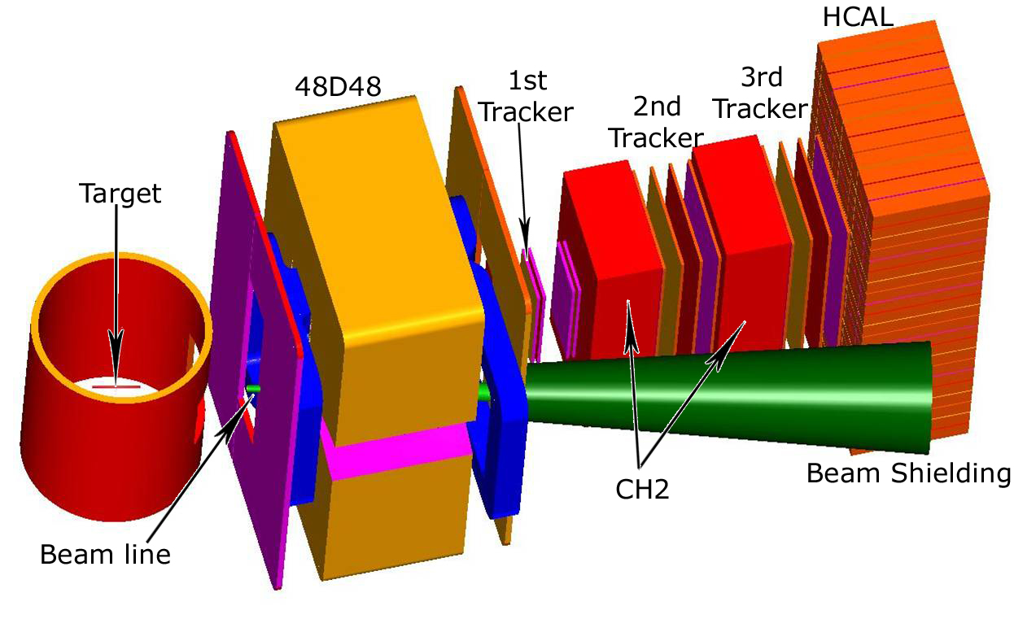
The Super BigBite (SBB) Hall A Spectrometer
(shown for small angle and with hadron detection instrumentation)
Large acceptance, moderate resolution
Wide angular and momentum coverage

Slide 17
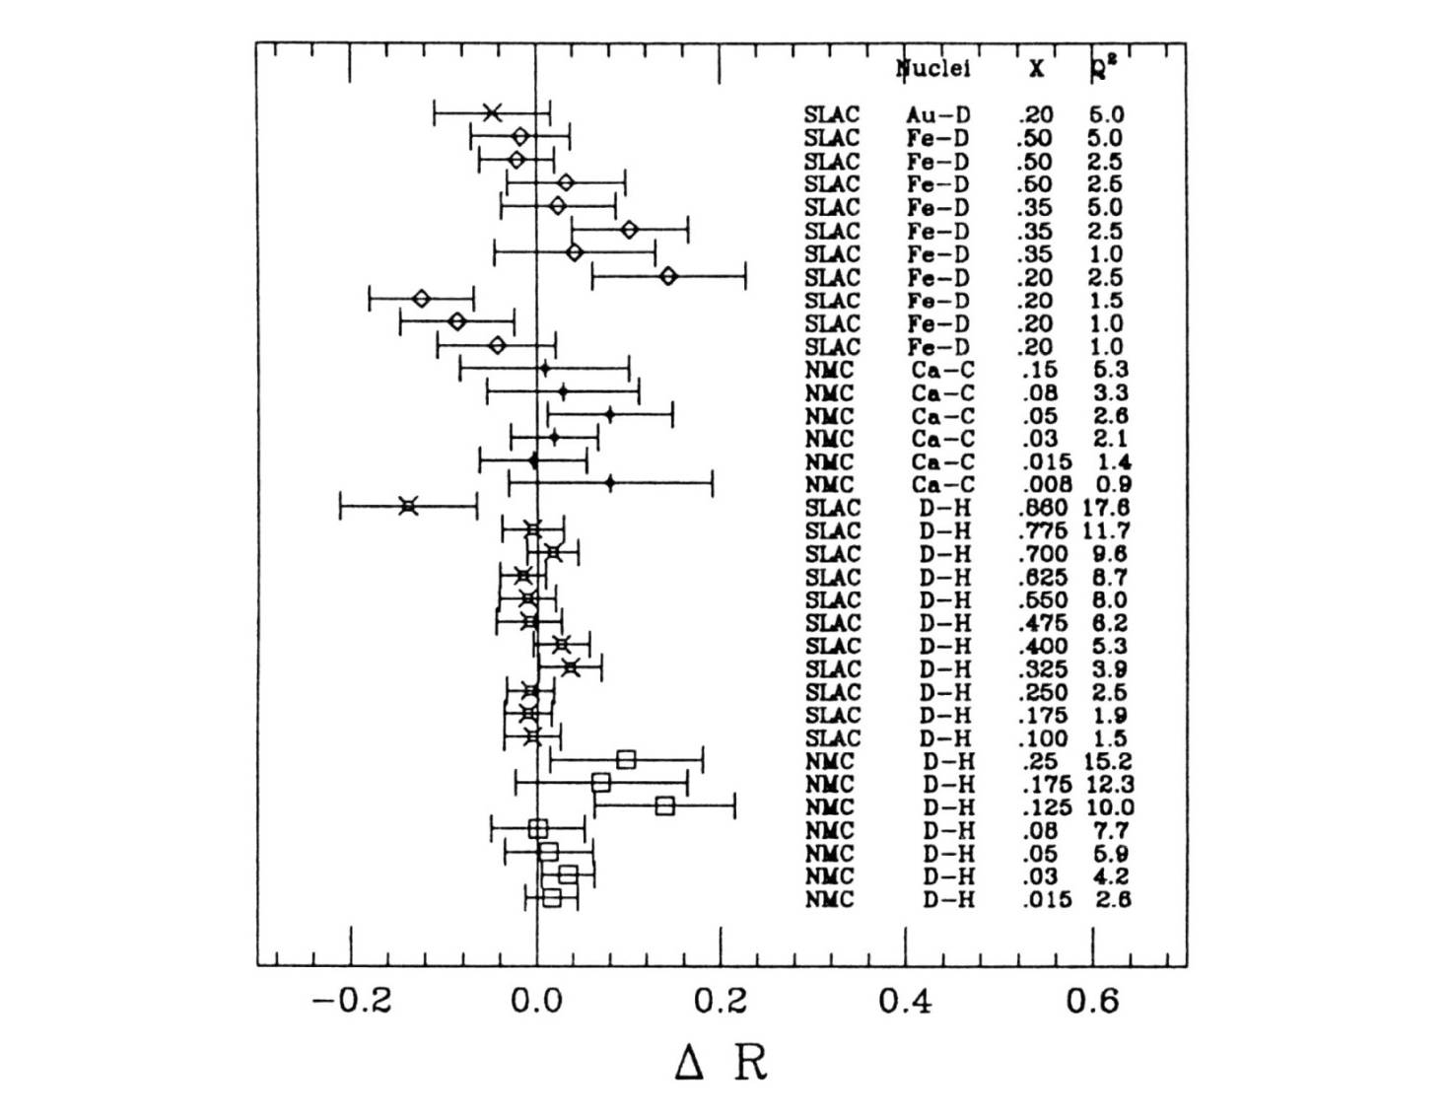
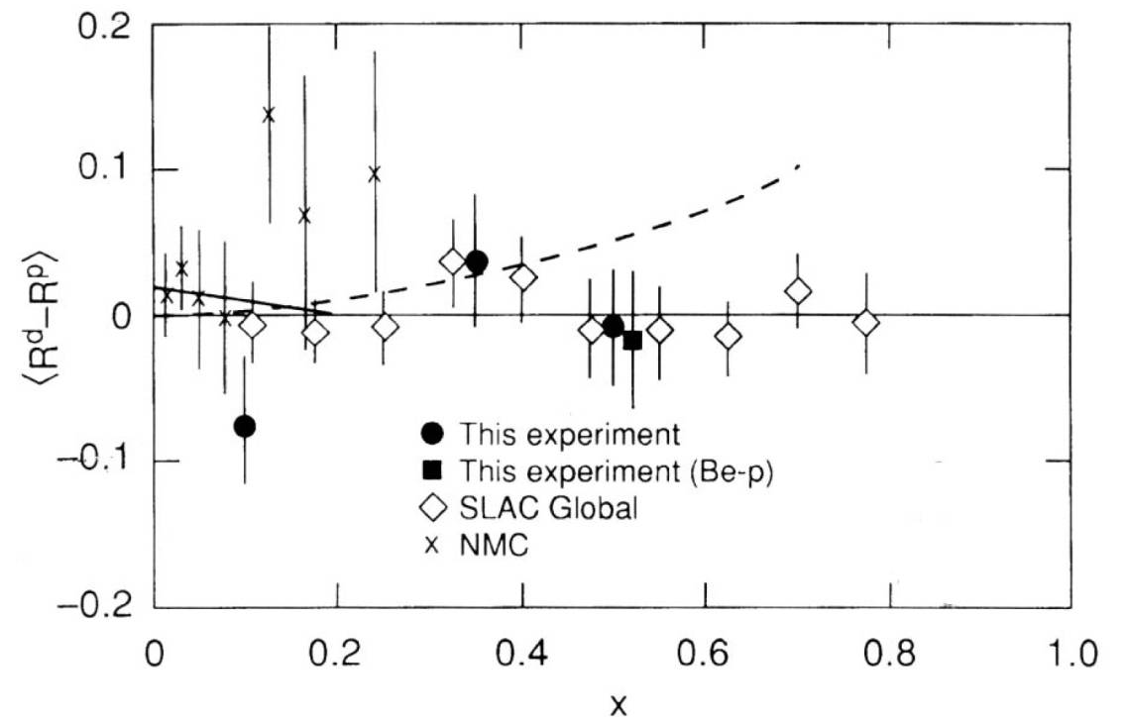
R=σ_{L}/σ_{T} Measurements
SLAC/CERN data show that the
ratio R=σ_{L}/σ_{T} is the same for all
nuclei within experimental errors
³He/³H JLab data will be of better precision
than SLAC data [wider angular (ε) range!]

Slide 18
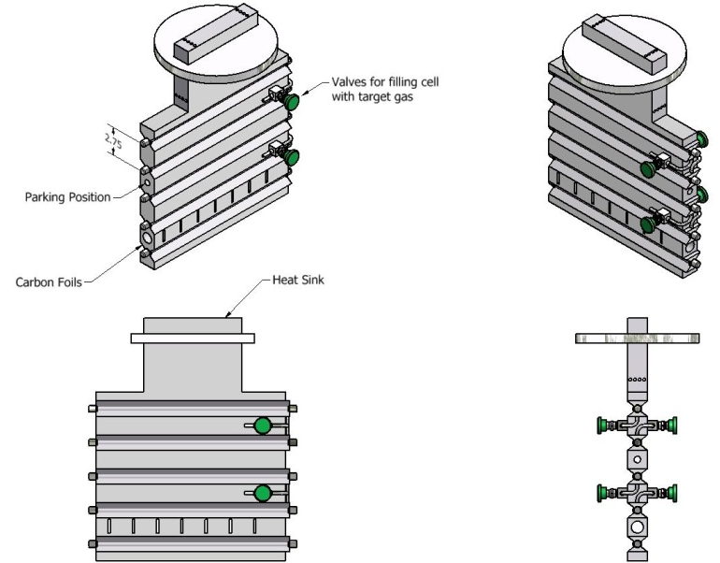
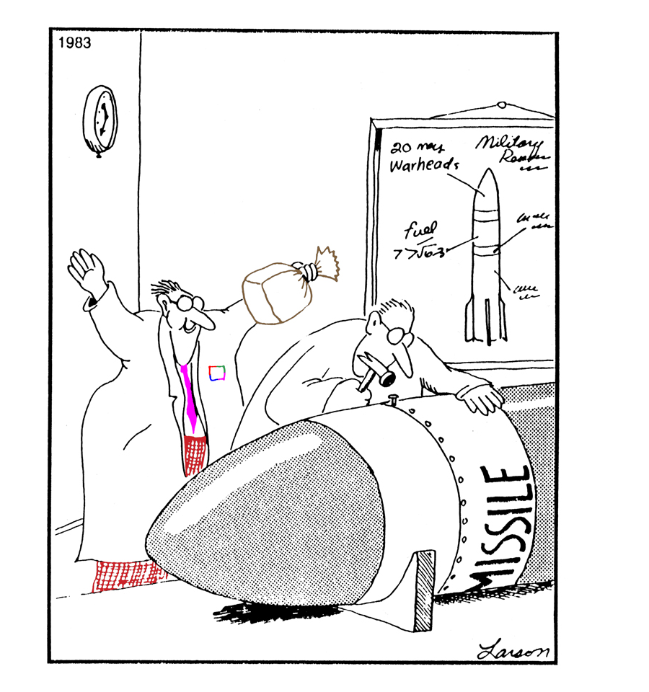
Tritium target at JLab
Tritium Target Task Force
E. J. Beise (U. of Maryland)
B. Brajuskovic (Argonne)
R. J. Holt (Argonne)
W. Korsch (U. of Kentucky)
A. T. Katramatou (Kent State U.)
D. Meekins (JLab)
T. O’Connor (Argonne)
G. G. Petratos (Kent State U.)
R. Ransome (Rutgers U.)
P. Solvignon (JLab)
B. Wojtsekhowski (JLab)
1000 Ci
E12-10-103 G. Petratos et al
PAC 36: conditionally approved
JLab Review: June 3, 2010
-> “No direct show stopper”

Slide 19
Curious tritium facts
Ship tritium gas Fedex, if < 1080 Ci
If >0.8 g or 8 kCi, nuclear facility
If >2000 psi, “tritium-assisted” embrittlement
Person at site boundary (95 m), 95th percentile meteorology for Norfolk, 8760 hours of data,100% HTO, < 3.4 mrem*
All 1000 Ci inhaled (extremely unlikely scenario)
64 mrem/mCi ingested -> 3.2 rem

Slide 20
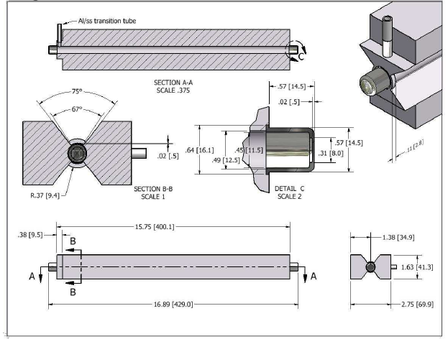
The Target System
(Tritium, Helium-3, Deuterium, Hydrogen, Aluminum Dummy)
The 5-cell assembly
Single cell
Details: Conceptual Design of a Tritium Gas Target for JLab, Tritium Target Task Force, Roy J. Holt et al., May 2010.

Slide 21
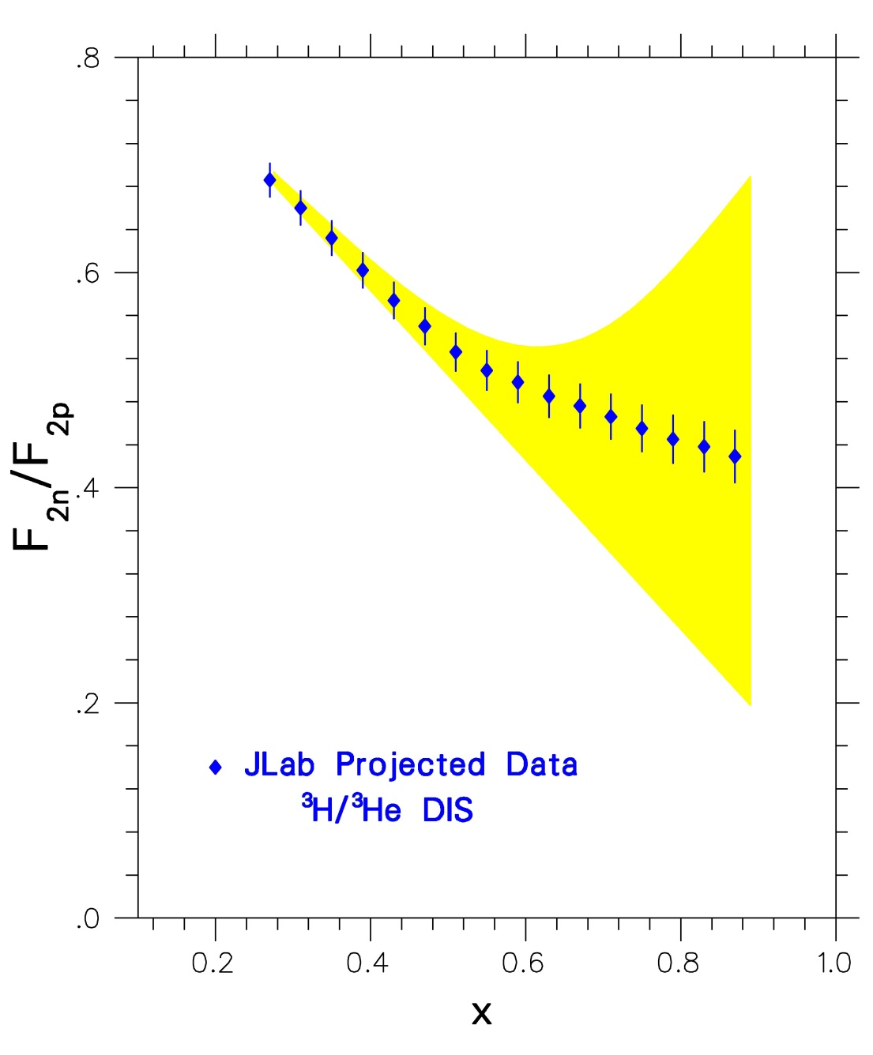
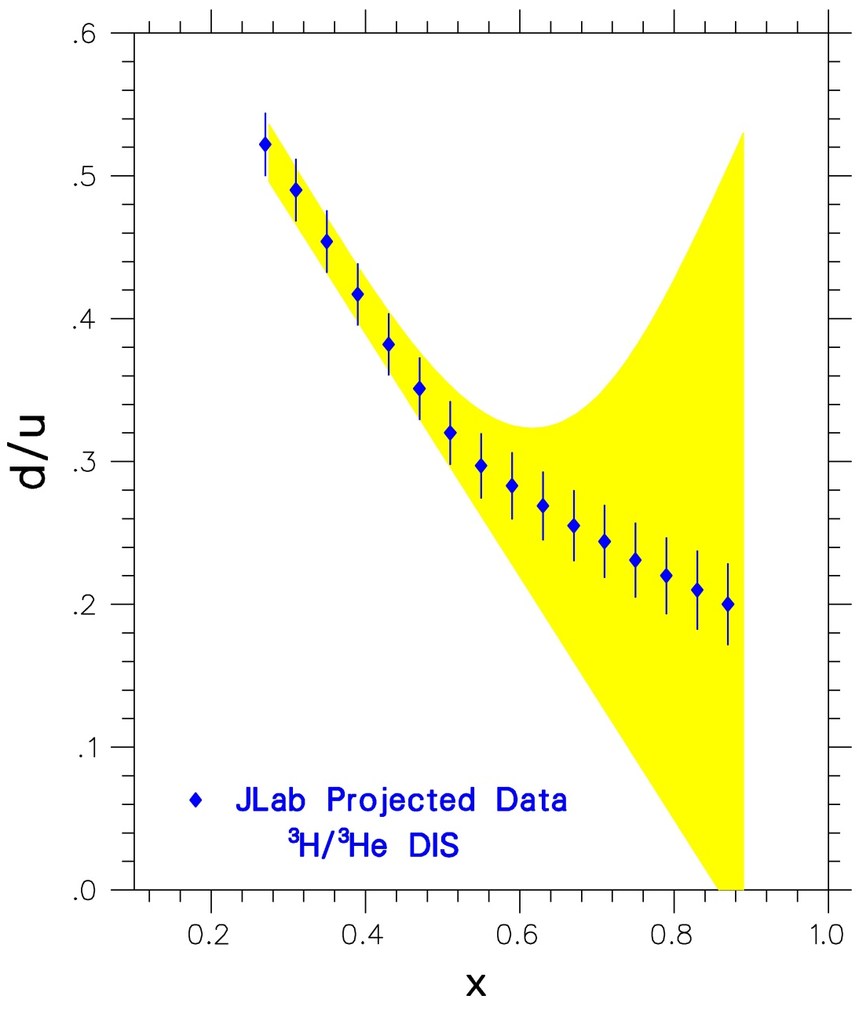
Possible Jlab - Hall A Data for F₂^{n}/F₂^{p} and d/u Ratios

Slide 22
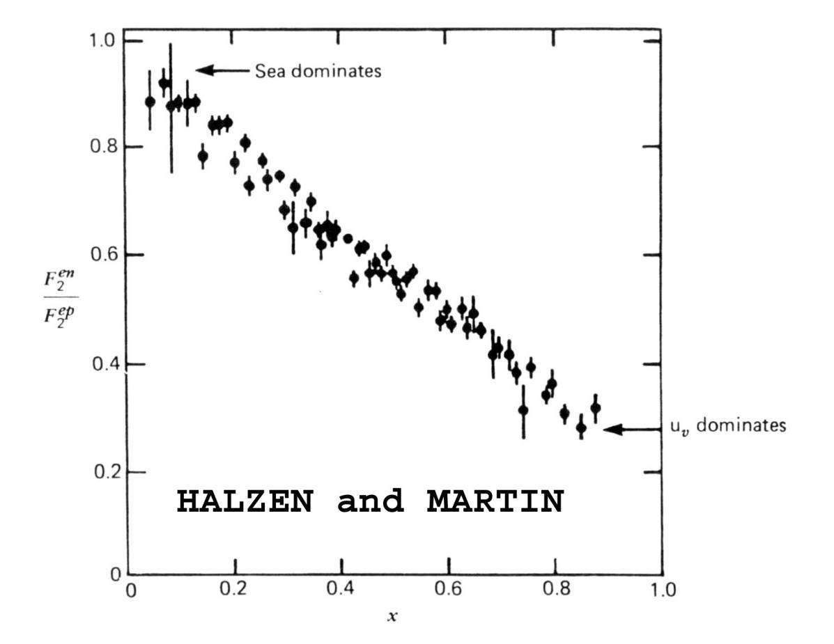
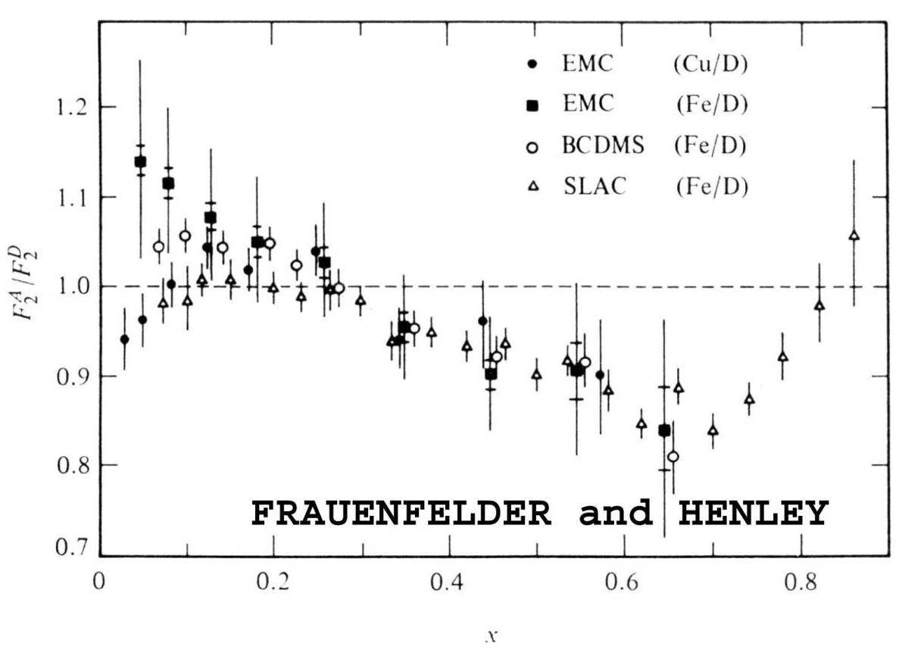
F₂^{n}/F₂^{p} Ratio and EMC Effect are Elementary
Undergraduate Nuclear-Particle Textbook Physics!

Slide 23
Other Physics Possibilities
Tritium target at Jlab opens up opportunities
Deep Inelastic scattering
x>1 Inelastic scattering
Quasi-elastic scattering
Elastic scattering
Semi-inclusive scattering
Collaboration has already submitted proposal for x>1.
Collaboration plans to submit at least an elastic proposal after full approval of deep inelastic measurements.

Slide 24
Summary
DIS from ³He and ³H with up to 11 GeV beams can provide:
Measurements of F₂^{n}/F₂^{p} and d/u ratios
Excellent constraint on models
Crucial EMC effect data for both A=3 systems
Input to light-nuclei structure theory
Input to structure function parametrizations needed for inter-
pretation of high energy collider and neutrino oscillations data
Textbook physics experiments – benchmark data
Opportunities for other large Q² measurements: elastic etc.

Slide 25
The Tritium Target System
Five-cell target structure (¹H, ²H, ³H, ³He, Al Dummy):
All cells: 40 cm long, 1.25 cm diameter, 25 µA max current
³H cell: 6.25 atm, 1000 Ci activity
¹H, ²H, ³He cells: 20 atm
Cells will be filled at STAR Facility of Idaho National Lab.
Target will be shipped to JLab using commercial services.
System will be enclosed in secondary “sealed” containment
vessel (no reliance on fast valves).
A catastrophic leak will be vented through stack above Hall A.
Resulting emission will keep tritium levels at the JLab site
boundary below regulatory limits.
More work to be done BUT JLab review did not find a show stopper for further development and operation of target at Jlab.

Slide 26
³He and ³H Structure Functions
Nucleon structure function in nucleus A in the Impulse
Approximation: extension of deuteron model (Melnitchouk
and Thomas):
For ³He:
With isospin symmetry:
Then for ³H:
Charge symmetry breaking effects are small!

Slide 27
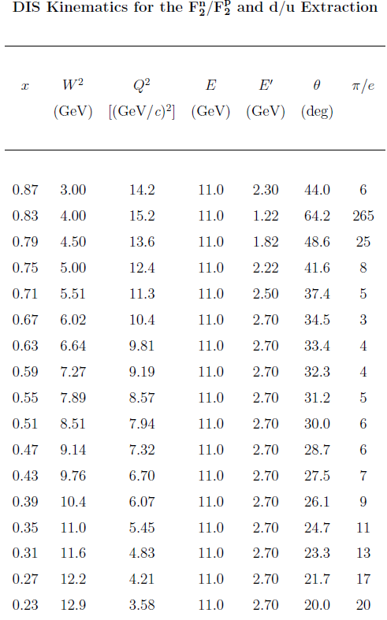

Slide 28
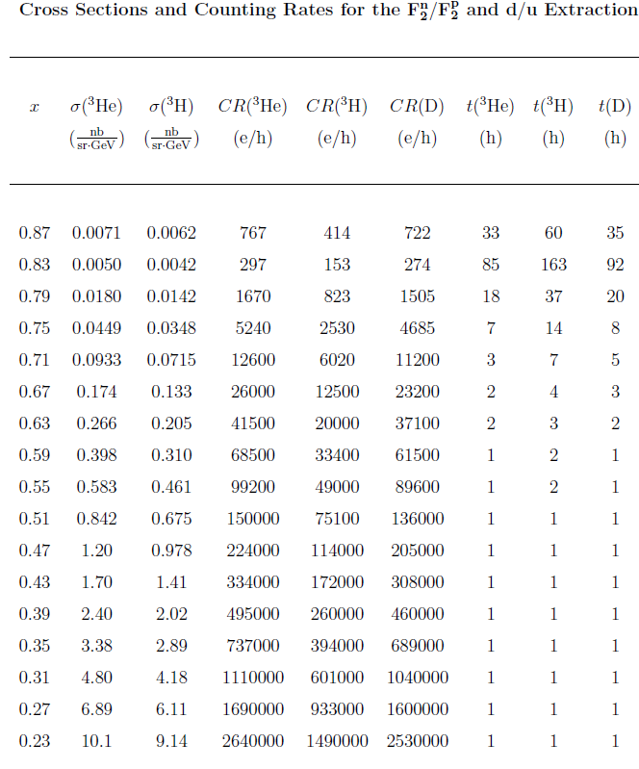

Slide 29
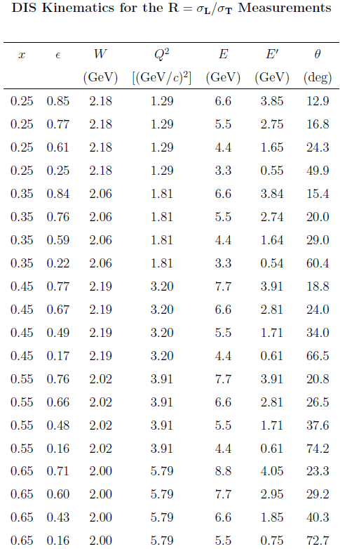

Slide 30
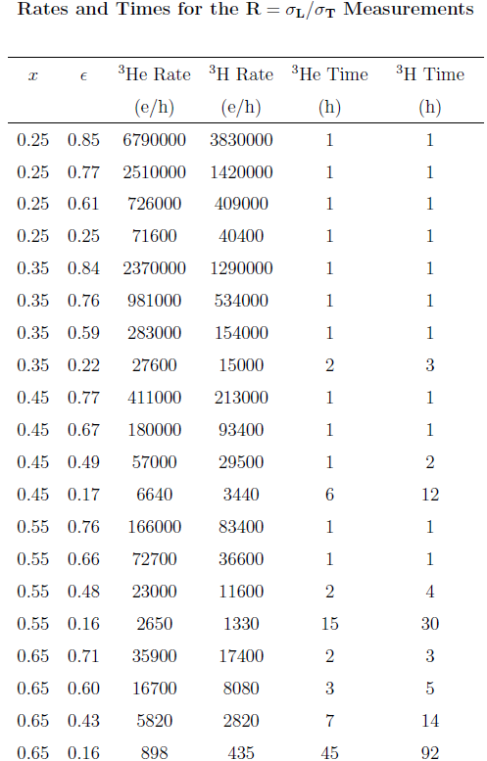

Slide 31
Beam Time Request (Hours)
Target | F₂^{n}/F₂^{p} | R=σ_{L}/σ_{T} | Experiment
³He | 176
³H | 330
D | 193
Sub-Total | 699
³He |  | 103
³H |  | 194
Sub-Total |  | 297
TOTAL |  |  | 996 hrs
 |  |  | 42 days

Slide 32
Worst Case Accident During Installation
Tritium containment breached during installation
1000 Ci of tritium lost in seconds
Worker in close proximity to target for 3 minutes before alarm
1000 Ci/10m³ x 1.2 m³/h x 3/60 x 0.0067 mrem/Ci = 40 mrem to worker
All 1000 Ci inhaled (extremely unlikely scenario)
0.005% is deposited in lungs -> 50 mCi deposited
64 mrem/mCi ingested -> 3.2 rem
JLab(DOE) annual limit is 1(5) rem
TMIST-2 Experiment at INL – Kanady example
1420 Ci -> I_{F} = 1.19E-5 -> 59.5 μrem

Slide 33
Worst Case Accident During Installation (continued)
Tritium containment breached in Hall A
Full instantaneous release
Polyethylene absorption rate: 0.13 mCi/s/m² at STP HT (J. Vac. Sci. Tech. A3 (1985) 1209)
Do nothing: reach 1000 dpm per 100 cm² in about 180 min
Turn on 24000 cfm exhaust after 1 hour, levels out at 650 dpm about 400 min from release
Tritium absorption in concrete: 0.01 mCi/s/m²
11 dpm in 100 cm² in an hour

Slide 34
Worst Case Accident
Tritium containment breached – with task fan
1000 Ci of tritium lost up 5-m stack in 1 hour
Person at site boundary (300 m), 95th percentile meteorology for Norfolk, 8760 hours of data -> 0.5 mrem*
HOTSPOT, “standard worst case” meteorology: 1 m/s windspeed, class F (“stable” atmosphere, ie minimal dispersion), 1 hour sampling time, 6% immediate conversion to HTO -> 6.2 mrem**
*GENII v. 2.09 NESHAPS – Bruce Napier, Pacific Northwest National Lab (2010)
**HOTSPOT – Bruce Napier, PNNL (2010)

Slide 35
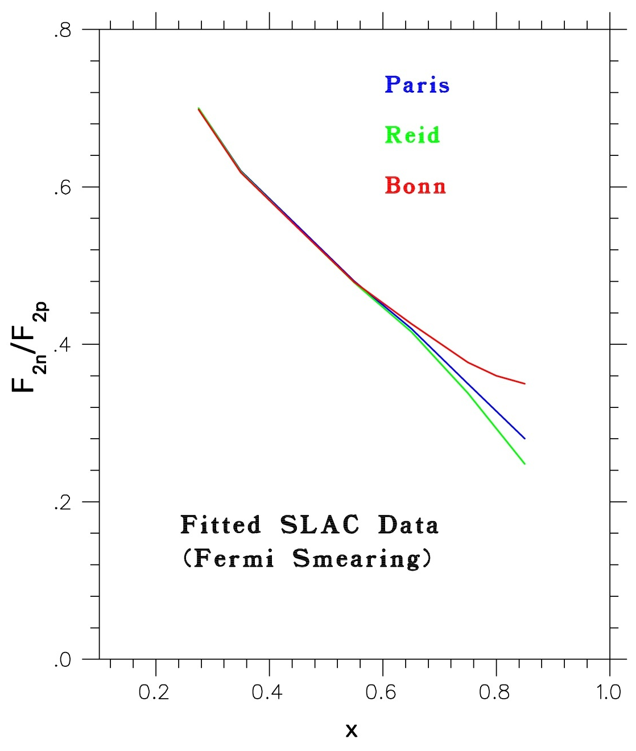
Standard analysis of F₂^{n/}F₂^{p} from
proton and deuteron data shows
large uncertainty at high-x values
depending on nucleon-nucleon
potential used.

Slide 36
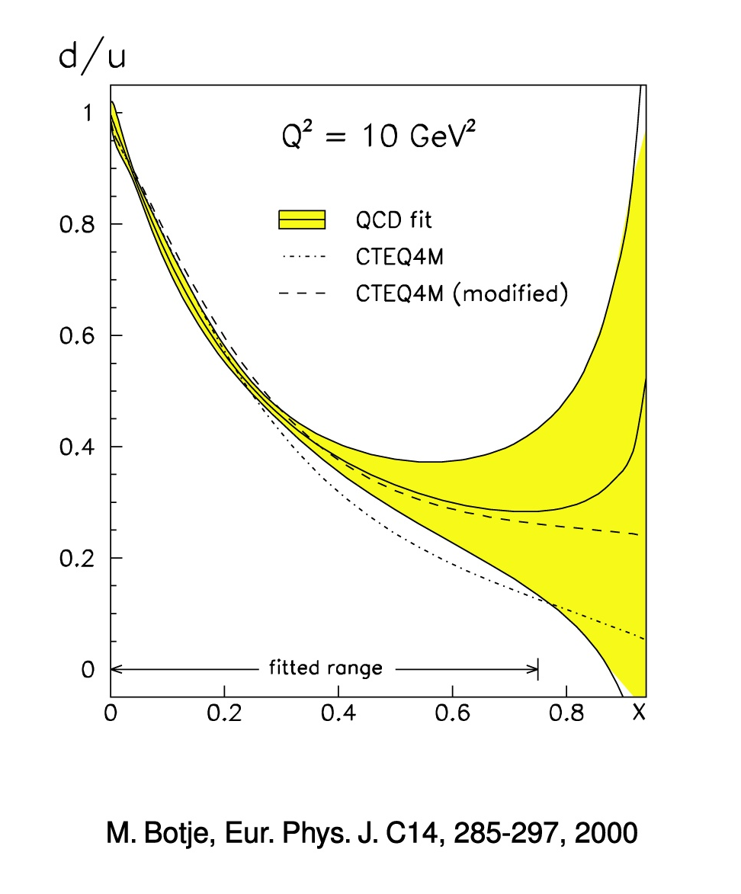

Slide 37
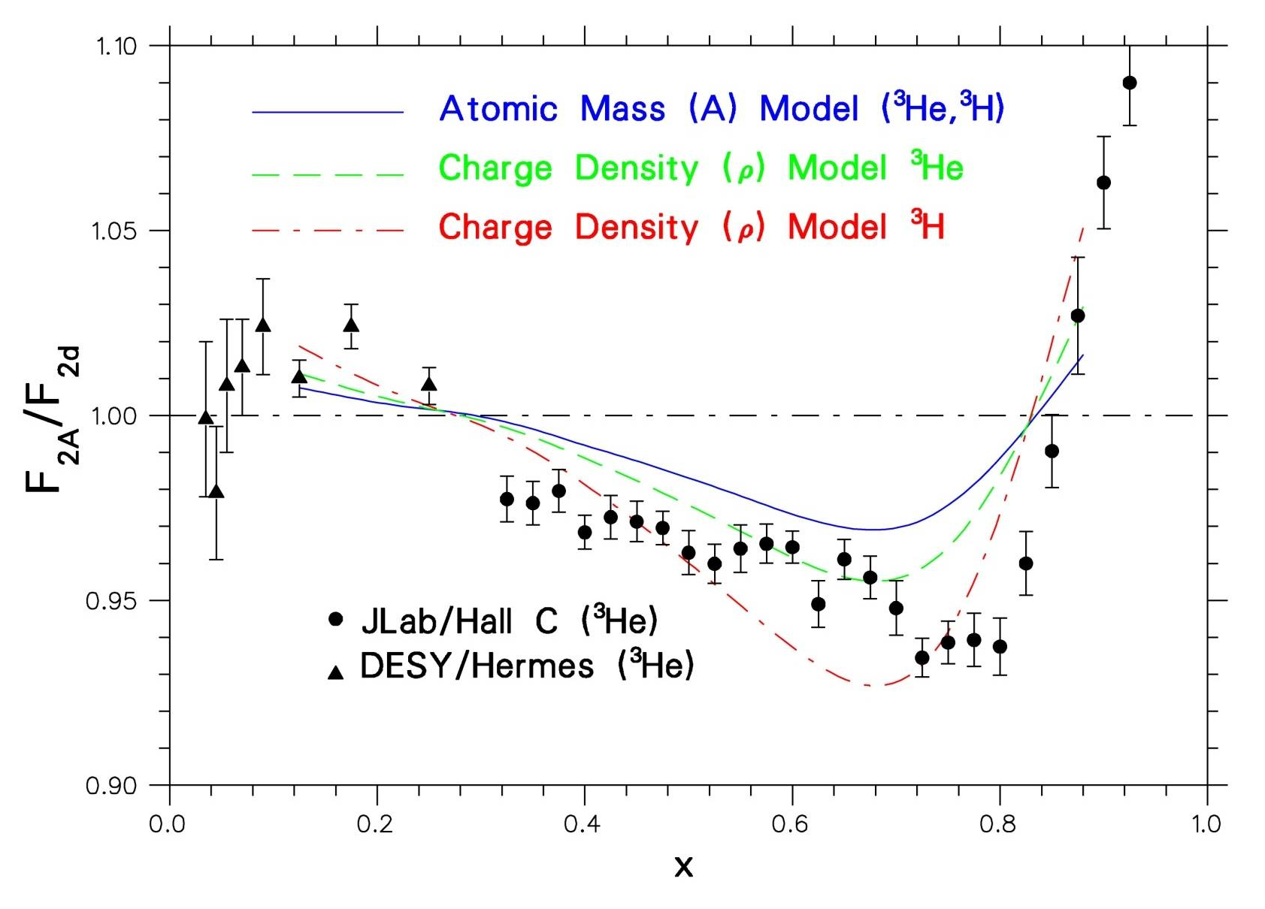
EMC Effect for A=3 Mirror Nuclei
Hall A data on ³H, ³He will be of similar precision to Hall C data

Slide 38
Hyperfine-Perturbed Quark Model
(Isgur 1999): Color-magnetic hyperfine interaction perturbs
proton energy: up quarks acquire higher average energy than
down quarks.
Perturbation results in mixed symmetry distributions that allow
the d quark to have different probability than the two u quarks.
Quark pairs with spin 0 (1) have their energies lowered (raised).
For x→ 1:
NOTE: Quark Model agrees with Diquark model and disagrees
with pQCD and Quark Counting Rules!

Slide 39
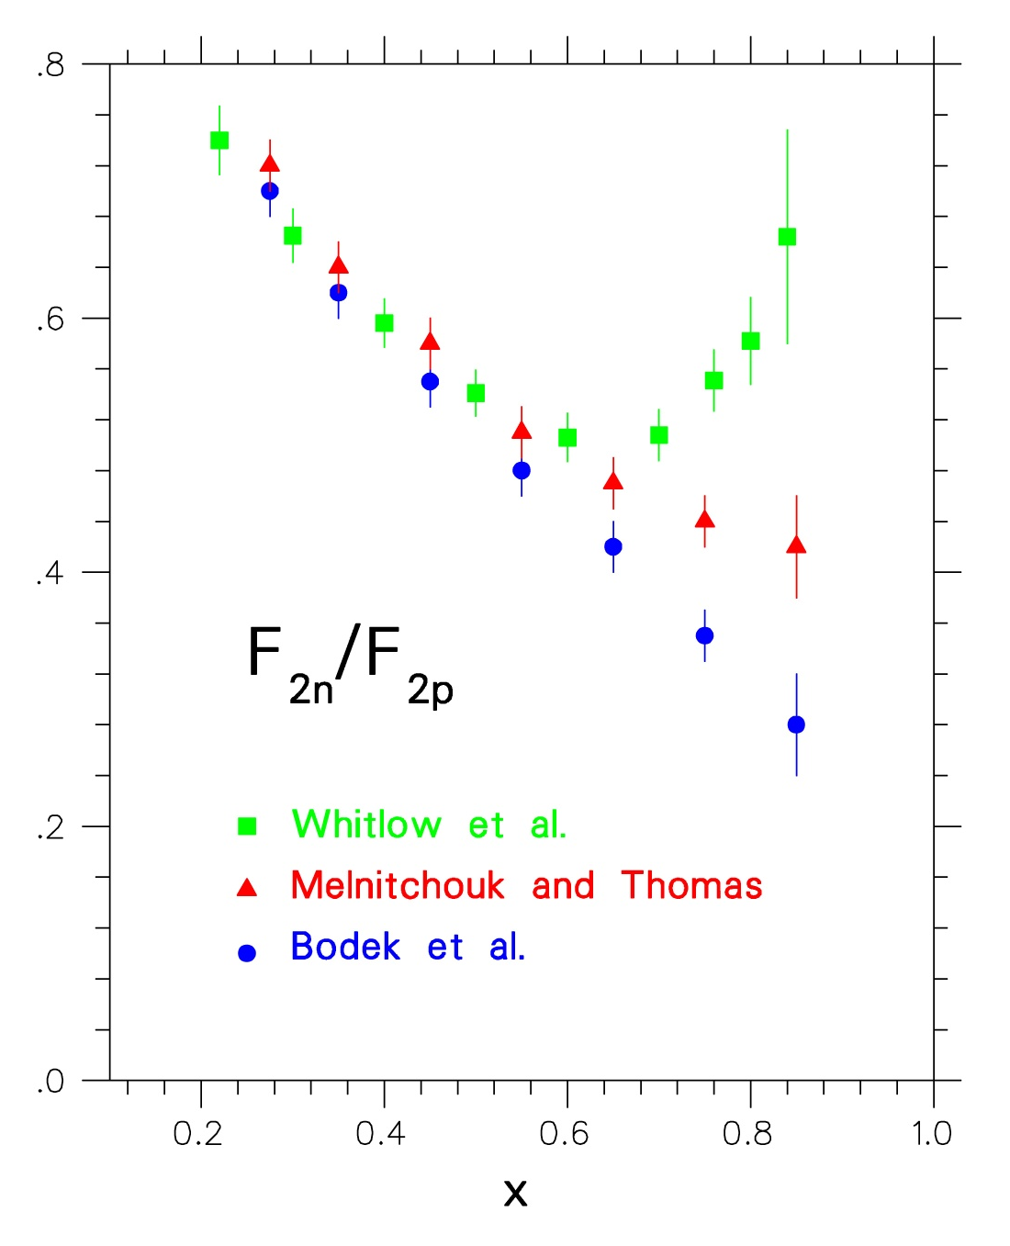
SLAC DIS Data
Whitlow: Density Model
M&T: Convolution Model
Bodek: Fermi-Smearing
Paris N-N potential

Slide 40
F₂^{n}/ F₂^{n}, d/u Ratios and A₁ Limits for x→1
 | F₂^{n}/F₂^{p} | d/u | A₁^{n} | A₁^{p}
SU(6) | 2/3 | 1/2 | 0 | 5/9
Diquark/Feynman | 1/4 | 0 | 1 | 1
Quark Model/Isgur | 1/4 | 0 | 1 | 1
Perturbative QCD | 3/7 | 1/5 | 1 | 1
Quark Counting Rules | 3/7 | 1/5 | 1 | 1
A₁: Asymmetry measured with polarized electrons and nucleons. Equal in
QPM to probability that the quark spins are aligned with the nucleon spin.
A₁^{p}, A₁^{n}: Extensive experimental programs at CERN, SLAC, DESY and
JLab (6 GeV and 12 GeV Programs)

Slide 41
Target Installation – Example of Procedure
Turn on Hall A exhaust fans (>24000 cfm should be sufficient)
When target container is received at JLab, survey with a hand-held tritium monitor
When opening the target container, survey with hand-held monitor
Swipe target in several places for tritium
Carefully unpack target, one person continuously surveying for tritium
Remove protective covers for shipping
Survey for x-rays if not done at INL
Load solid targets into frame if this has not been done prior to shipment
Attach W mask to target frame if this has not been done prior to shipment
Attach scattering chamber top flange to target assembly if not done prior to shipment
Attach crane to top flange
Lift target to position directly above scattering chamber
Two target-trained installers with proper ppe will carefully guide target into chamber
When target is seated, remove crane and begin bolting target flange to chamber
Place vent hood over target and activate exhaust fan
Check target alignment, make adjustments as necessary
Begin pumpdown of target in chamber after all seals have been made
Begin monitoring pump exhaust for tritium
Activate depleted U bed
Set up MKS rad-hard RGA (QTC54537) on mass 6 peak and remote monitor/interlock
Hook up target cooling, monitors and all interlocks; activate cooling and interlocks
Test all monitors and interlocks
Perform special checklist before leaving hall – two target operators
Target should be ready for beam alignment – described in written document

Slide 42
Binding/EMC Effect in Deuteron
Deuteron structure function convolution: Calculated in a
covariant frame-work in terms of free nucleon structure
functions (Melnitchouk and Thomas 1996) :
Spectral function f(y) accounts for Fermi Motion AND
Binding/Off-Shell Effects, where y is the fraction of the
nucleus momentum carried by the struck nucleon.
Density Model: EMC effect for deuteron scales with
nuclear charge density as for heavy nuclei (Frankfurt and
Strikman 1988, applied by Whitlow et al. 1992) :

Slide 43
Target Removal – Example of Procedures
Turn on Hall A exhaust fan (~24000 cfm)
Allow target cells to “cool” as much as possible, Al target cell will be activated, preferably for 4 days
Survey target area
When safe, remove all monitors, cooling and cabling
Put on approved ppe
Unbolt top target flange
Remove vent hood and attach crane to top target flange
Begin tritium monitoring with hand held monitor
Carefully, lift target ladder out of the scattering chamber
Swipe tritium target cell and scattering chamber for tritium
Survey target cells once again away from pivot to determine activity
Move target to target container area and remove W mask and top flange if necessary
Attach shipping covers to target
Place target ladder in target container and re-pack
Seal target container, ready for shipment

Slide 44
Summary of Key Engineering Controls
Small amount of tritium gas (1000 Ci) – MIT-Bates: 150 x larger sample
Small diameter cell with beam collimator
Super Big Bite Spectrometer
All tritium handling performed offsite at Idaho National Lab
Target cell completely sealed
Secondary containment with scattering chamber
Scattering chamber: fast valves to accelerator or isolated
³He pressure is three times ³H pressure - same beam time on each target.
Target and scattering chamber will be designed for ease of installation
Beam interlocks
Radiation level in Hall
Beam current
Raster (in progress in Hall A)
Target vacuum
Target coolant flow
Tritium monitor
Independent vent hood and task fan in target area
High velocity task fan interlocked to tritium detection, vacuum

Slide 45
Proposed Administrative Controls
Beam current should be limited to 30 μA
Overhead crane locked out after target installation
Trained tritium target operators on shift at all times
Beam condition, raster pattern and target parameters monitored
Accelerator operators given special instructions
Independent operator check on beam current, raster, interlocks
Full written and approved procedures for all operations with target
All procedures to be performed and checked – two trained target operators
Target installation and removal
Target alignment
Target storage
Target motion
Beam on target

Slide 48
Faddeev
Variational

Slide 49
Broken SU(6) Quark Model – Regge Theory
Close (1973): Used the SU(6) proton wave function with
diquark spectator configuration with spin s=1 suppressed
relative to spin s=0:
If ψ₁(x) → 0 as x→ 1:
Feynman/Carlitz(1975): Considered scattering probability
from a quark with a spectator diquark, using Regge Theory:
For x→ 1:

Slide 50
Perturbative QCD
(Farrar/Jackson 1975): When diquark spins are aligned,
only exchange of longitudinal gluons is permitted.
Compton scattering amplitude is suppressed by (1-x)^{1/2}
factor.
Quark carrying nearly all momentum of nucleon (x~1)
must have same helicity as nucleon.
For x→ 1 (different predictions!):
Quark Counting Rules assuming exchange of hard
gluons (Brodsky et al. 1995) result in same predictions.

